Slide 1
Unit 3-4
Polygon Angle Sum Theorem
PLANE Geometry

Slide 2
Polygon:
A closed plane figure with at least three sides. The sides intersect only at their endpoints, and no adjacent sides are collinear.
Polygon
Not a Polygon

Slide 3






Example 1:
N$ame the$Polygon and identify its angles and sides.
$$B$$
$$C$$
$$A$$
$$D$$
$$F$$
$$E$$

Slide 4
SIDES | Name
3 | Triangle
4 | Quadrilateral
5 | Pentagon
6 | Hexagon
7 | Heptagon
8 | Octagon
9 | Nonagon
10 | Decagon
12 | Dodecagon
n | n-gon
Classify a Polygon by Sides

Slide 5










Classify Polygon by Shape
Convex
A Polygon that has No Diagonal With Points Outside the Polygon.
Concave
A Polygon that has At Least 1 Diagonal with Points Outside the Polygon.
$$B$$
$$A$$
$$B$$
$$A$$
$$C$$
$$C$$
$$E$$
$$D$$
$$E$$
$$D$$

Slide 6




Example 2:
Classify each Polygon by Sides and Shape.
$$A)$$
$$B)$$

Slide 7

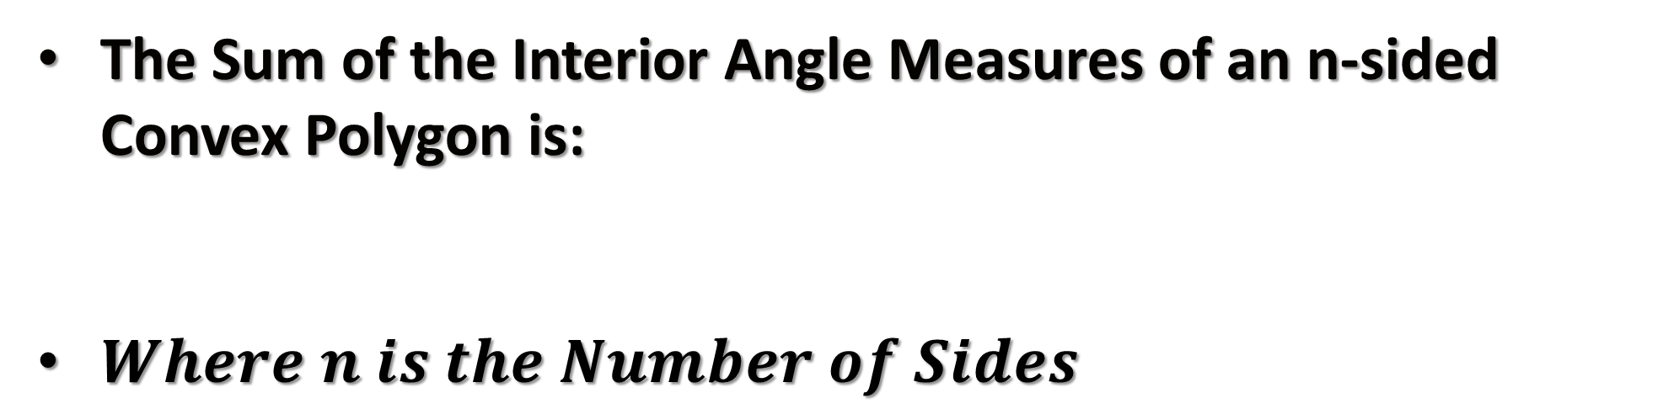
Polygon Interior Angles Sum
The Sum of the Interior Angle Measures of an n-sided Convex Polygon is:
$Where n is the Number of Sides$
$$Sum=(n−2)∙180$$

Slide 8




Example 3:
Find The Sum of the Interior Angles of the Given Polygon.
$$A)$$
$$B)$$
$$Heptagon$$
$$C)$$
$$22−Gon$$

Slide 9








Example 4:
Find $m∠X.$
$$T$$
$$X$$
$$100°$$
$$W$$
$$130°$$
$$U$$
$$V$$

Slide 10


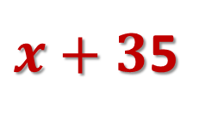

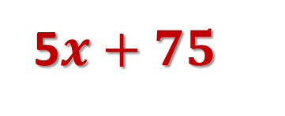
Example 5:
Find $x.$
5$x+75$
$x+3$5
$$x+15$$
$$3x+25$$

Slide 11



Polygon Exterior Angles Sum
The Sum of the Exterior Angles of a Polygon is Equal to 360.
$$2$$
$$m∠1+m∠2+m∠3=360°$$
$$1$$
$$3$$

Slide 12
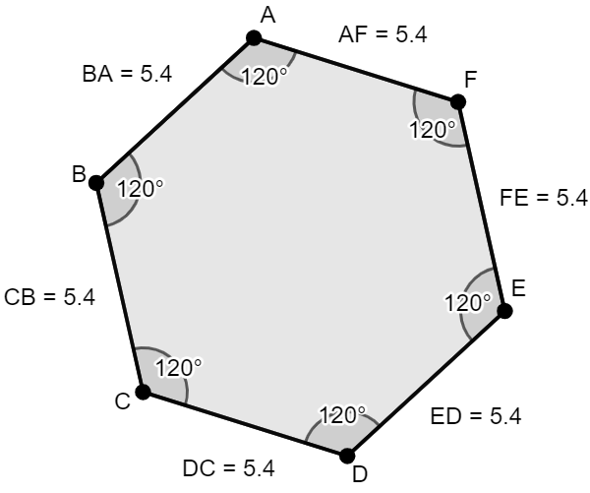
Regular Polygon
Equilateral Polygon: All Sides Congruent
Equiangular Polygon: All Angles Congruent
Regular Polygon: A Polygon the is Both Equilateral and Equiangular

Slide 13






Find The Sum of the Interior Angles, the Measure of One Interior Angle, and the Measure of One Exterior Angle.
Example 6:
$$A)$$
$$B)$$
$$C)$$
$$Triangle$$
$$Octagon$$
$$19−Gon$$

